Slide 1

Development of Chatbot Using Speech Recognition
Done By :
Basani Priyanka(A20513566)
pbasani@hawk.iit.edu
Depala Rajeswari (A20526535) rdepala@hawk.iit.edu
Vinitha Inaganti (A20514310) vinaganti@hawk.iit.edu

Slide 2


Agenda
Introduction
Problem Statement
Data Preprocessing
Naïve Bayes Algorithm
LSTM
Speech Recognition and GUI
Future work

Slide 3
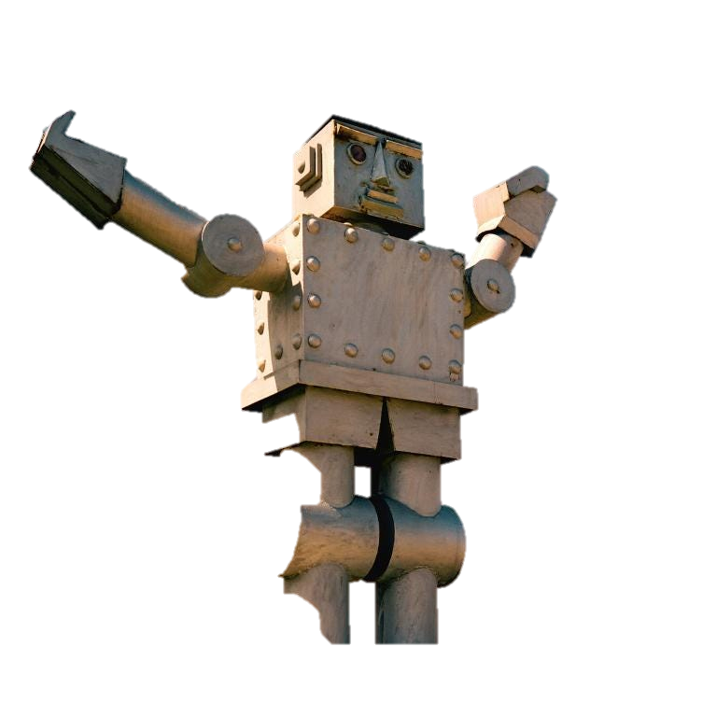
Introduction
Chatbots aim to resemble human conversation by collecting and generating responses to user requests using a knowledge base and interpreter software.
The knowledge base includes question and answer patterns, context,
and subject titles.
Chatbots can also perform tasks like audio and image search, fact-finding,
weather forecasting, and currency conversion, often using external APIs.
To generate responses, algorithms analyze and parse the user's text, considering
morphology and relationship subjects.

Slide 4
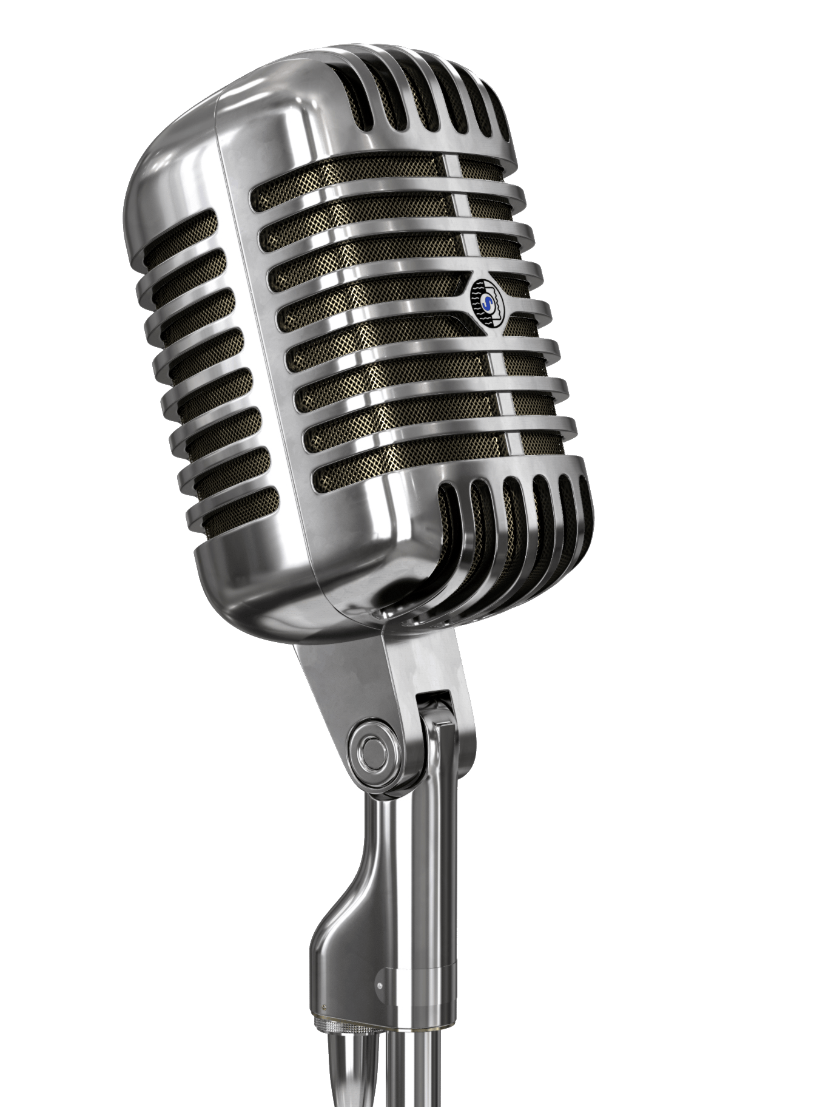

Problem Statement
Chatbots are computer software designed to mimic human conversation and provide
information to users through text or voice.
Chatbots use natural language processing, a branch of machine learning, to understand
and interpret customer queries received through speech recognition.
By understanding the context and meaning behind customer queries, chatbots can
provide accurate responses and resolve issues without the need for human intervention.
This allows for 24/7 availability and quick resolution of customer issues, improving
customer satisfaction and reducing workload for live support staff.
This Photo by Unknown Author is licensed under CC BY-NC

Slide 5
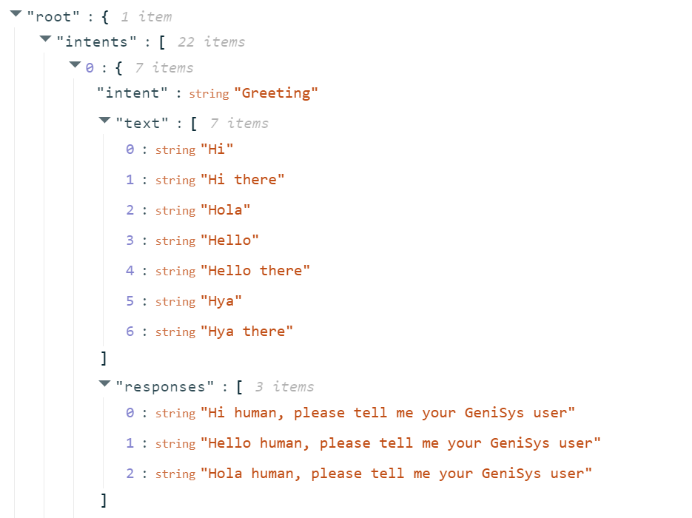
Data Preprocessing
Data is obtained from an open source called Kaggle which contains huge number of datasets from the link
What Is the Data Like ?
The data is in the format .json file which contains an array of intents that contains 22 objects.
Each intent has several properties which are
“texts” - an array of strings reflecting several ways the
chatbot may be answered by the user
“responses” - an array of strings describing different
replies the chatbot could provide when received.

Slide 6
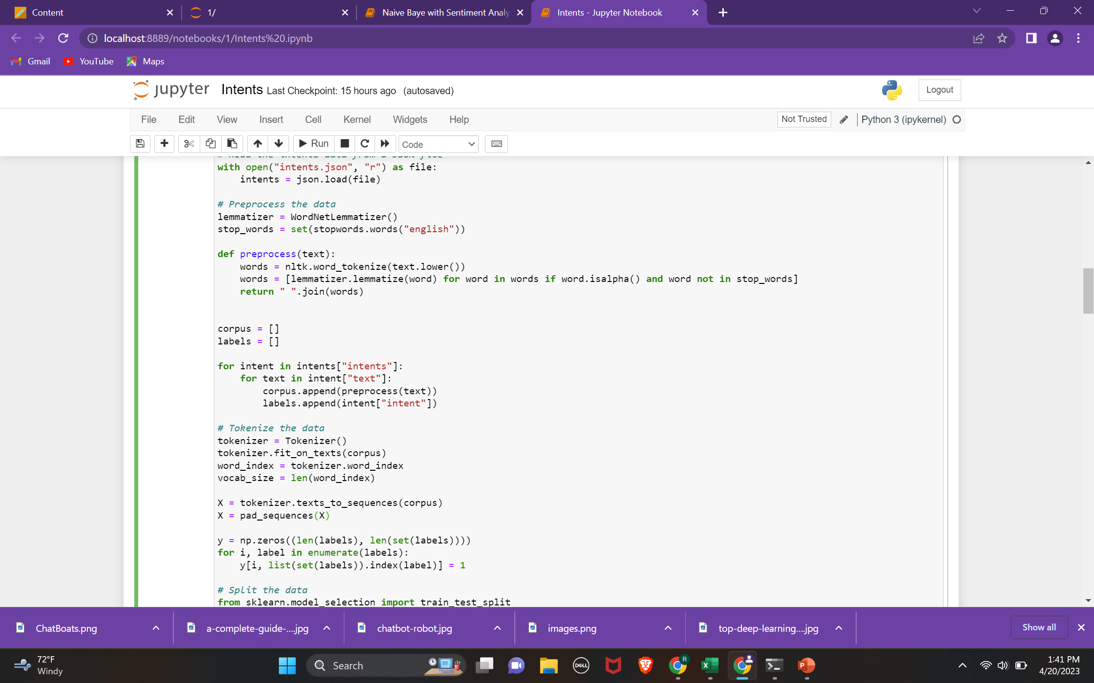
Continued……
Now we preprocess the data using the function which tokenizes the text and lemmatizes the remaining words
Take an example of text “Hello5 peoples, How are you” => “hello people how are you”
And we pad sequences because feeding sequences of variable length to a neural network because neural networks require fixed input shapes

Slide 7
Continued…… How function works?
Hello5 peoples, How are you?
hello people how are you
“ ”.join(words)
import nltk
from nltk.stem import WordNetLemmatizer
from nltk.corpus import stopwords
Preprocess
hello
people
how
are
you
nltk.word_tokenize(text.lower())
WordNetLemmatizer
hello5
peoples,
how
hello5
peoples
how
hello
peoples
how
are
you?
are
you
are
you
stopwords.words("english")
isalpha()

Slide 8
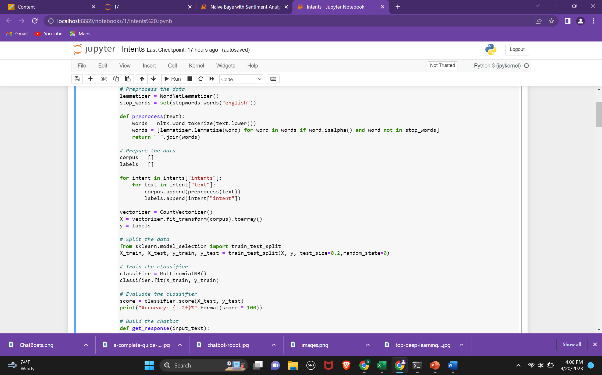
Continued…… CountVectorizer ( Naïve Bayes )
from sklearn.feature_extraction.text import CountVectorizer
The sun is shining today
["and", "is", "it", "outside", "shining", "sun", "sunny", "the", "today", "warm"]
[[0 1 1 0 1 1 0 1 1 0],
[1 1 1 1 0 0 1 1 0 1]]
It is sunny and warm outside
lines
and | is | it | outside | shining | sun | sunny | the | today | warm
0 | 1 | 1 | 0 | 1 | 1 | 0 | 1 | 1 | 0
1 | 1 | 1 | 1 | 0 | 0 | 1 | 1 | 0 | 1

Slide 9
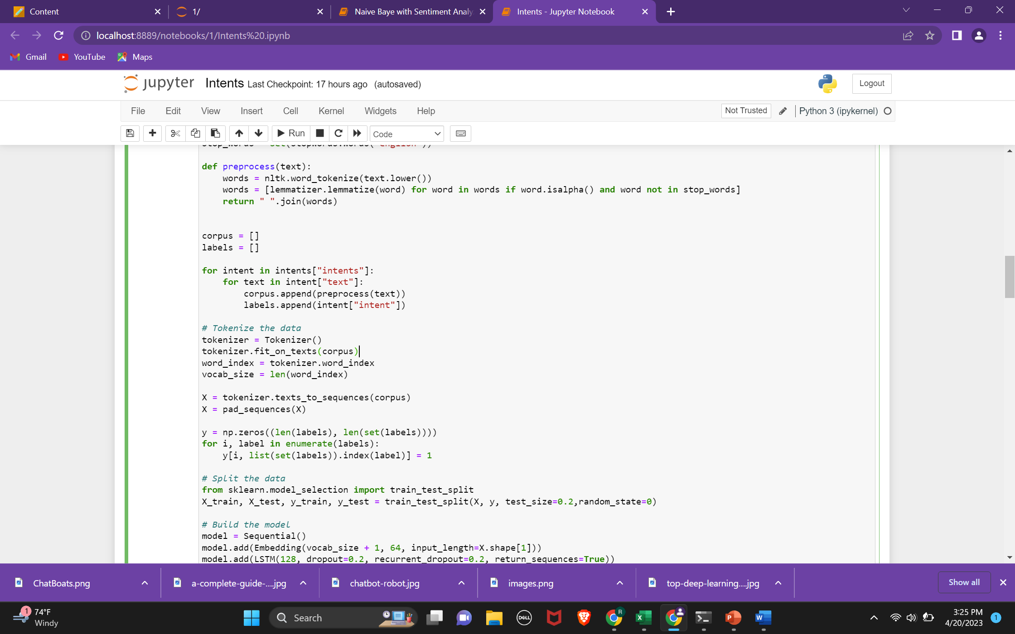
Continued…… Pad sequences (Neural Network)
from tensorflow.keras.preprocessing.text import Tokenizer
from tensorflow.keras.preprocessing.sequence import pad_sequences
lines
Honesty is the best policy
{Honesty : 1, is : 2 , the : 3 , best:4 , policy : 5 , sky : 6, blue :7}}
{[1 2 3 4 5],[3 6 2 7]}
The sky is blue
tokenizer.word_index
X=tokenizer.texts_to_sequences(lines)
pad_sequences(X)
Vocab Size = 7
{[1 2 3 4 5],[0 3 6 2 7]}

Slide 10
Naïve Bayes Approach
The Naive Bayes method is a probabilistic classification model that predicts the likelihood of a given input belonging to a specific category.
One of the advantages of the Naive Bayes approach is its simplicity and efficiency, making it a popular choice for chatbot development
from sklearn.feature_extraction.text import CountVectorizer
from sklearn.naive_bayes import MultinomialNB

Slide 11
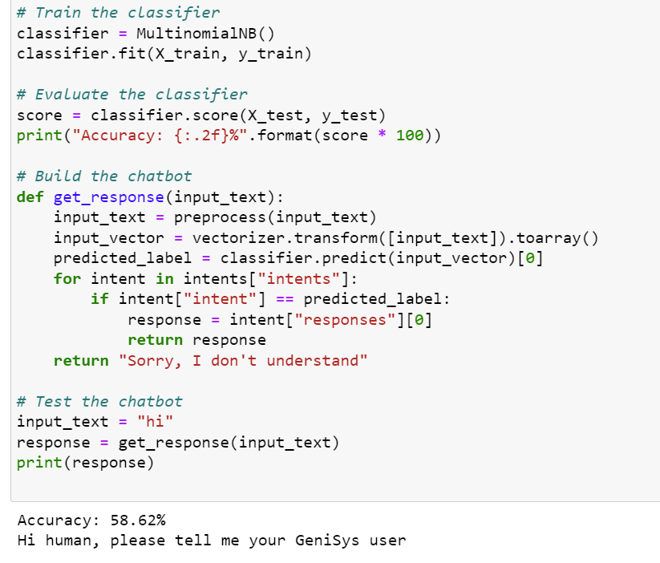
Continued……

Slide 12
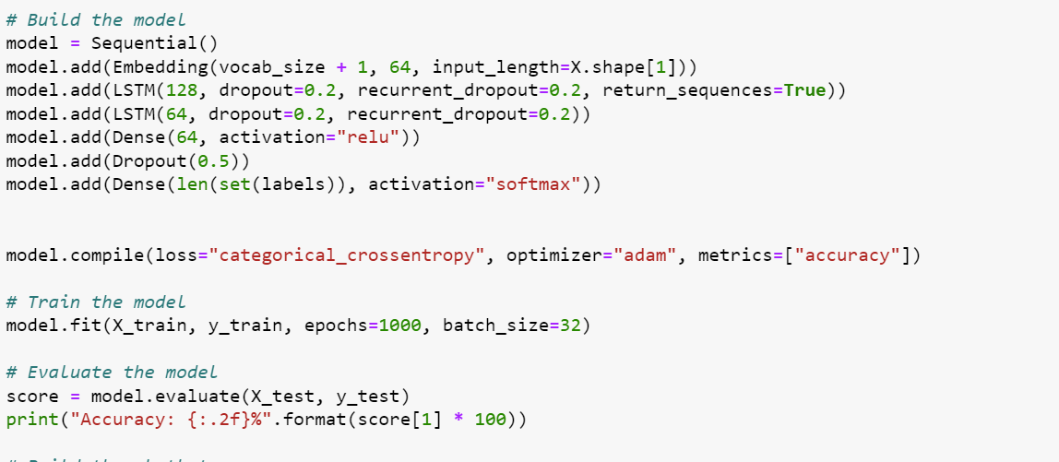
Long Short-Term Memory (LSTM)
A type of recurrent neural network (RNN) architecture developed to overcome the vanishing gradient problem in standard RNNs.
In a chatbot, LSTM analyses user input via many layers to provide a response based on patterns learnt from training data. This method can lead to more natural and interesting talks.

Slide 13
Continued…… MODEL ARCHITECTURE
INPUT LAYER
DENSE LAYER
EMBEDDING
LAYER
LSTM 1 (128
UNITS) LAYER
LSTM 2 (64
UNITS) LAYER
ReLu
DROPOUT
LAYER
SoftMax
DENSE LAYER
drops 50%

Slide 14
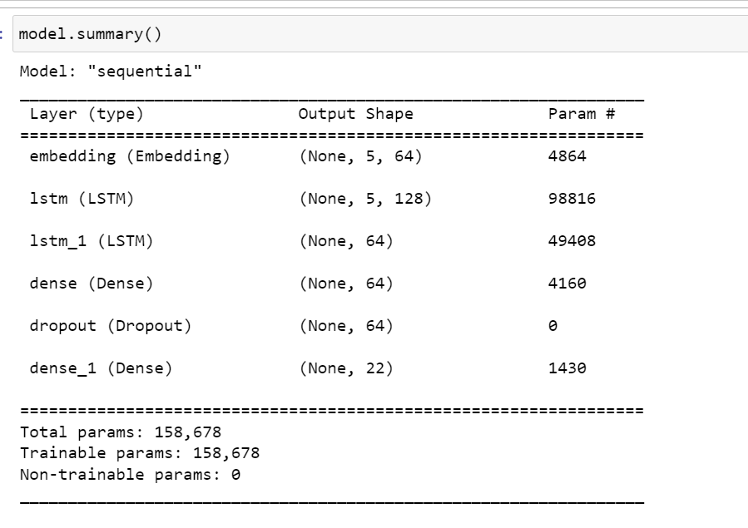
Model Summary
This model is a sequential neural network built for
text categorization problems.
It employs an embedding layer to generate dense
vector representations for each word in the input
sequence, as well as two LSTM layers to capture
long-term relationships in the input sequence.
The last dense layers add nonlinearity within the
network and are utilized for categorization.

Slide 15
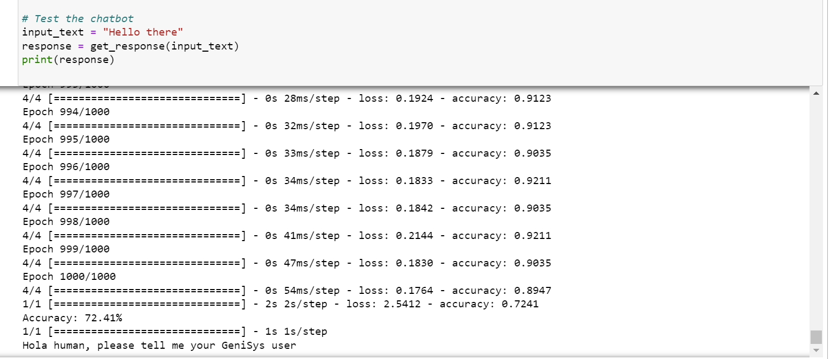
Model Accuracy

Slide 16
Which Model is best?
Because they can manage long-term dependencies and complicated patterns in natural language, LSTMs are employed in chatbot creation.
In contrast, Naive Bayes is a simpler and quicker method that is often used for text classification applications like spam detection.
While Naive Bayes can be effective for some chatbot creation tasks, LSTMs are typically chosen because of their capacity to learn from both previous and present input.

Slide 17
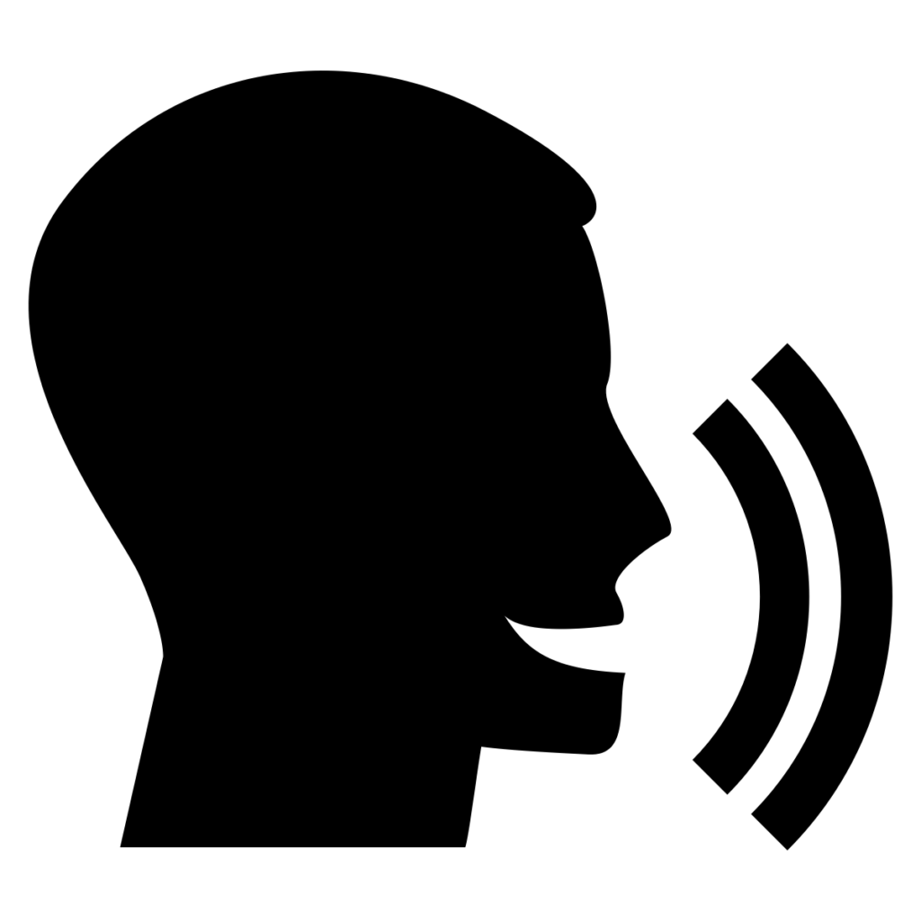
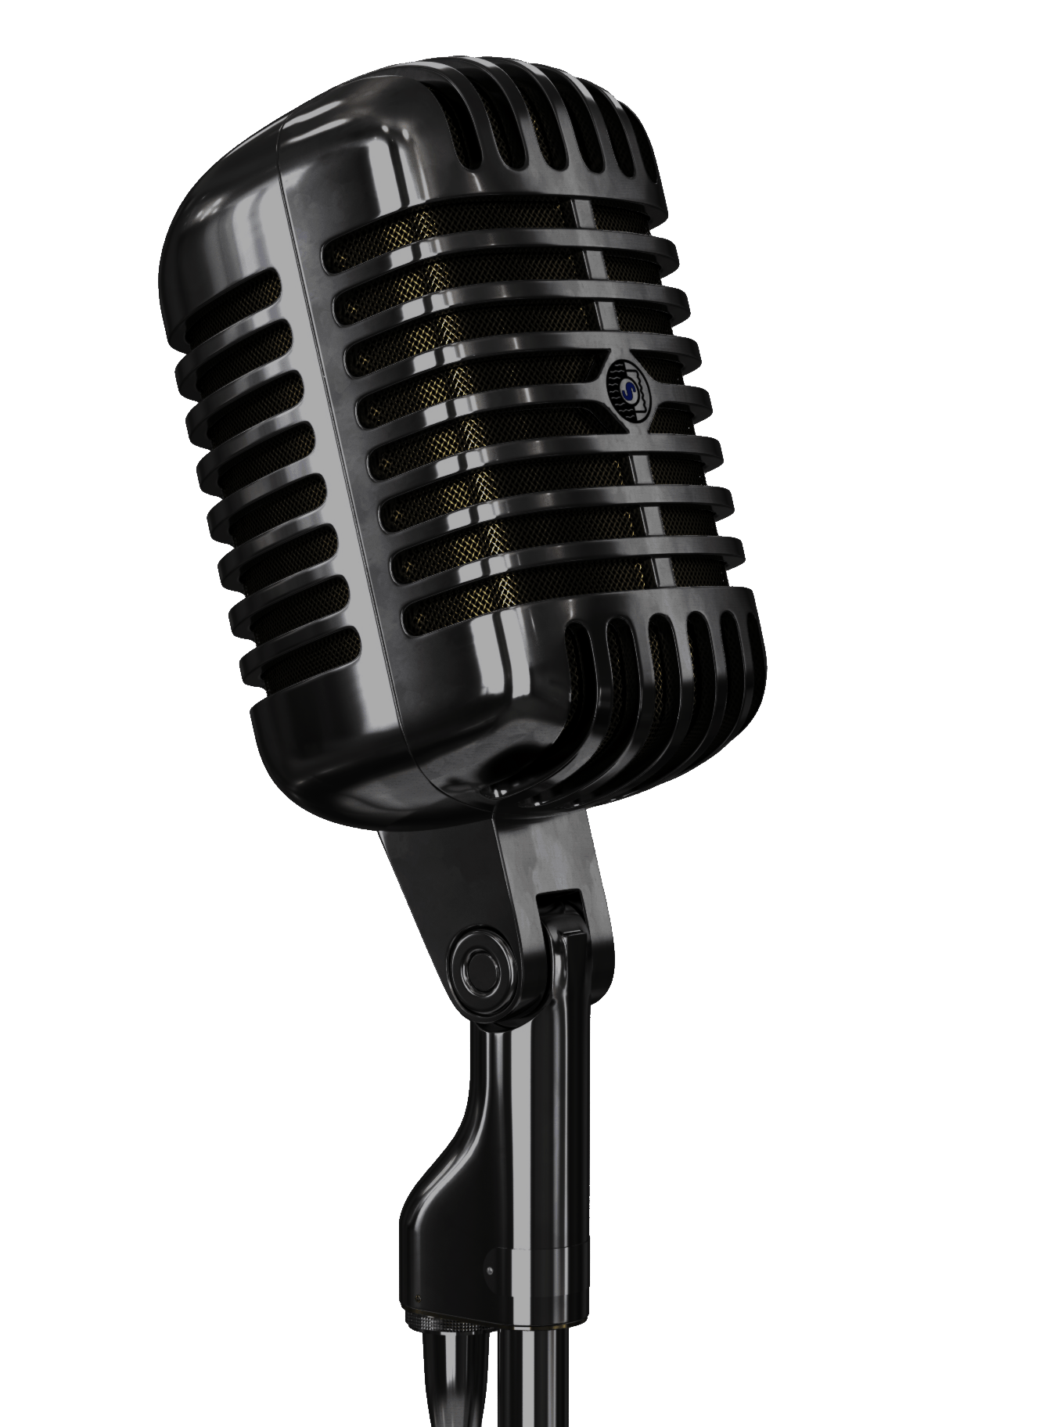
Speech Recognition
import speech_recognition as sr
YOU : Hello
BOT : How can I help you
This Photo by Unknown Author is licensed under CC BY
This Photo by Unknown Author is licensed under CC BY-NC

Slide 18
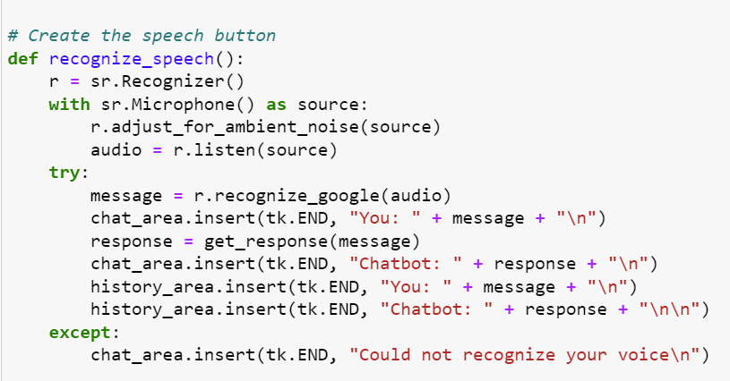
Continued……
It instantiates a Recognizer object and uses it to listen to the microphone input.
After that, the audio data is transferred to the Google Speech Recognition API, which converts the speech to text.
Speech recognition is the process of a computer software turning spoken words into text or instructions using machine learning and signal processing techniques.

Slide 19
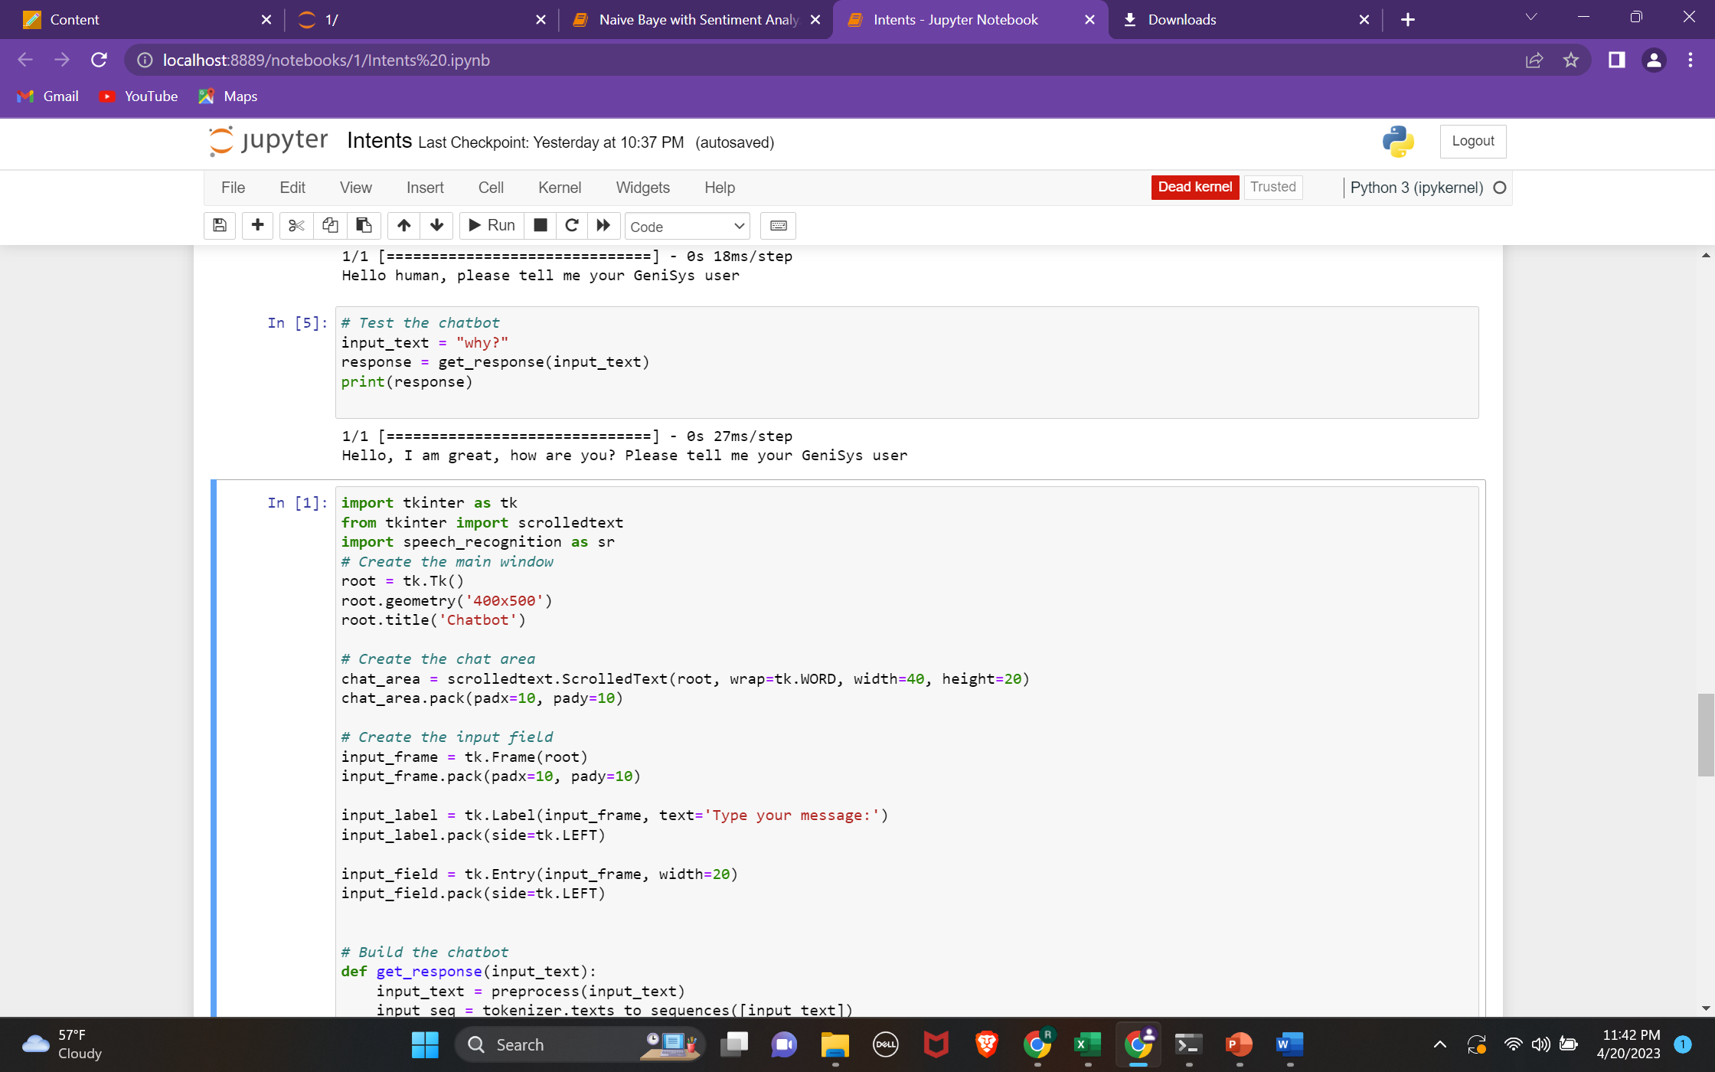
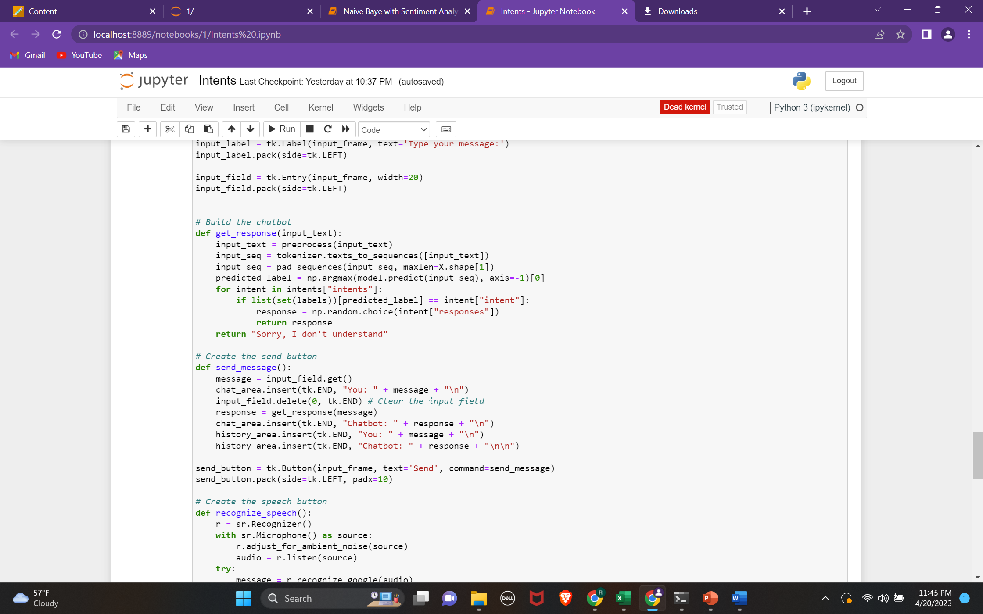
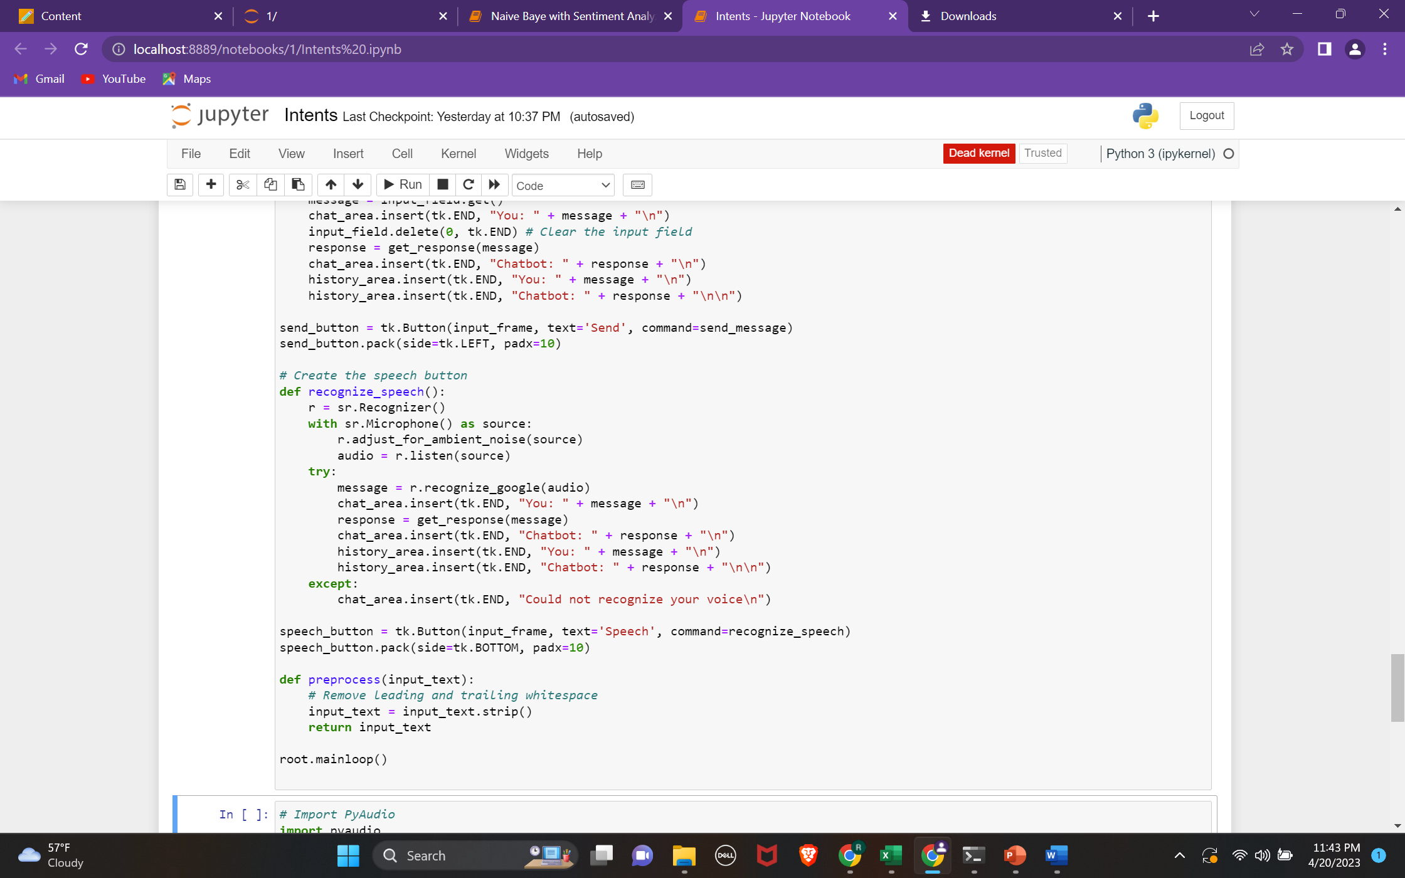
GUI Using Tkinter
import tkinter as tk
from tkinter import scrolledtext

Slide 20
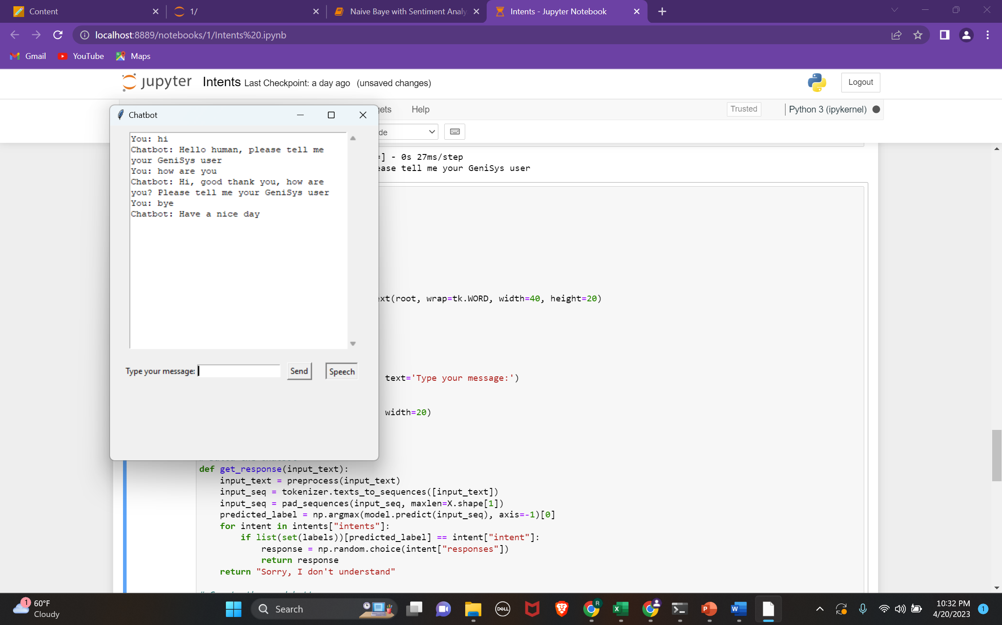
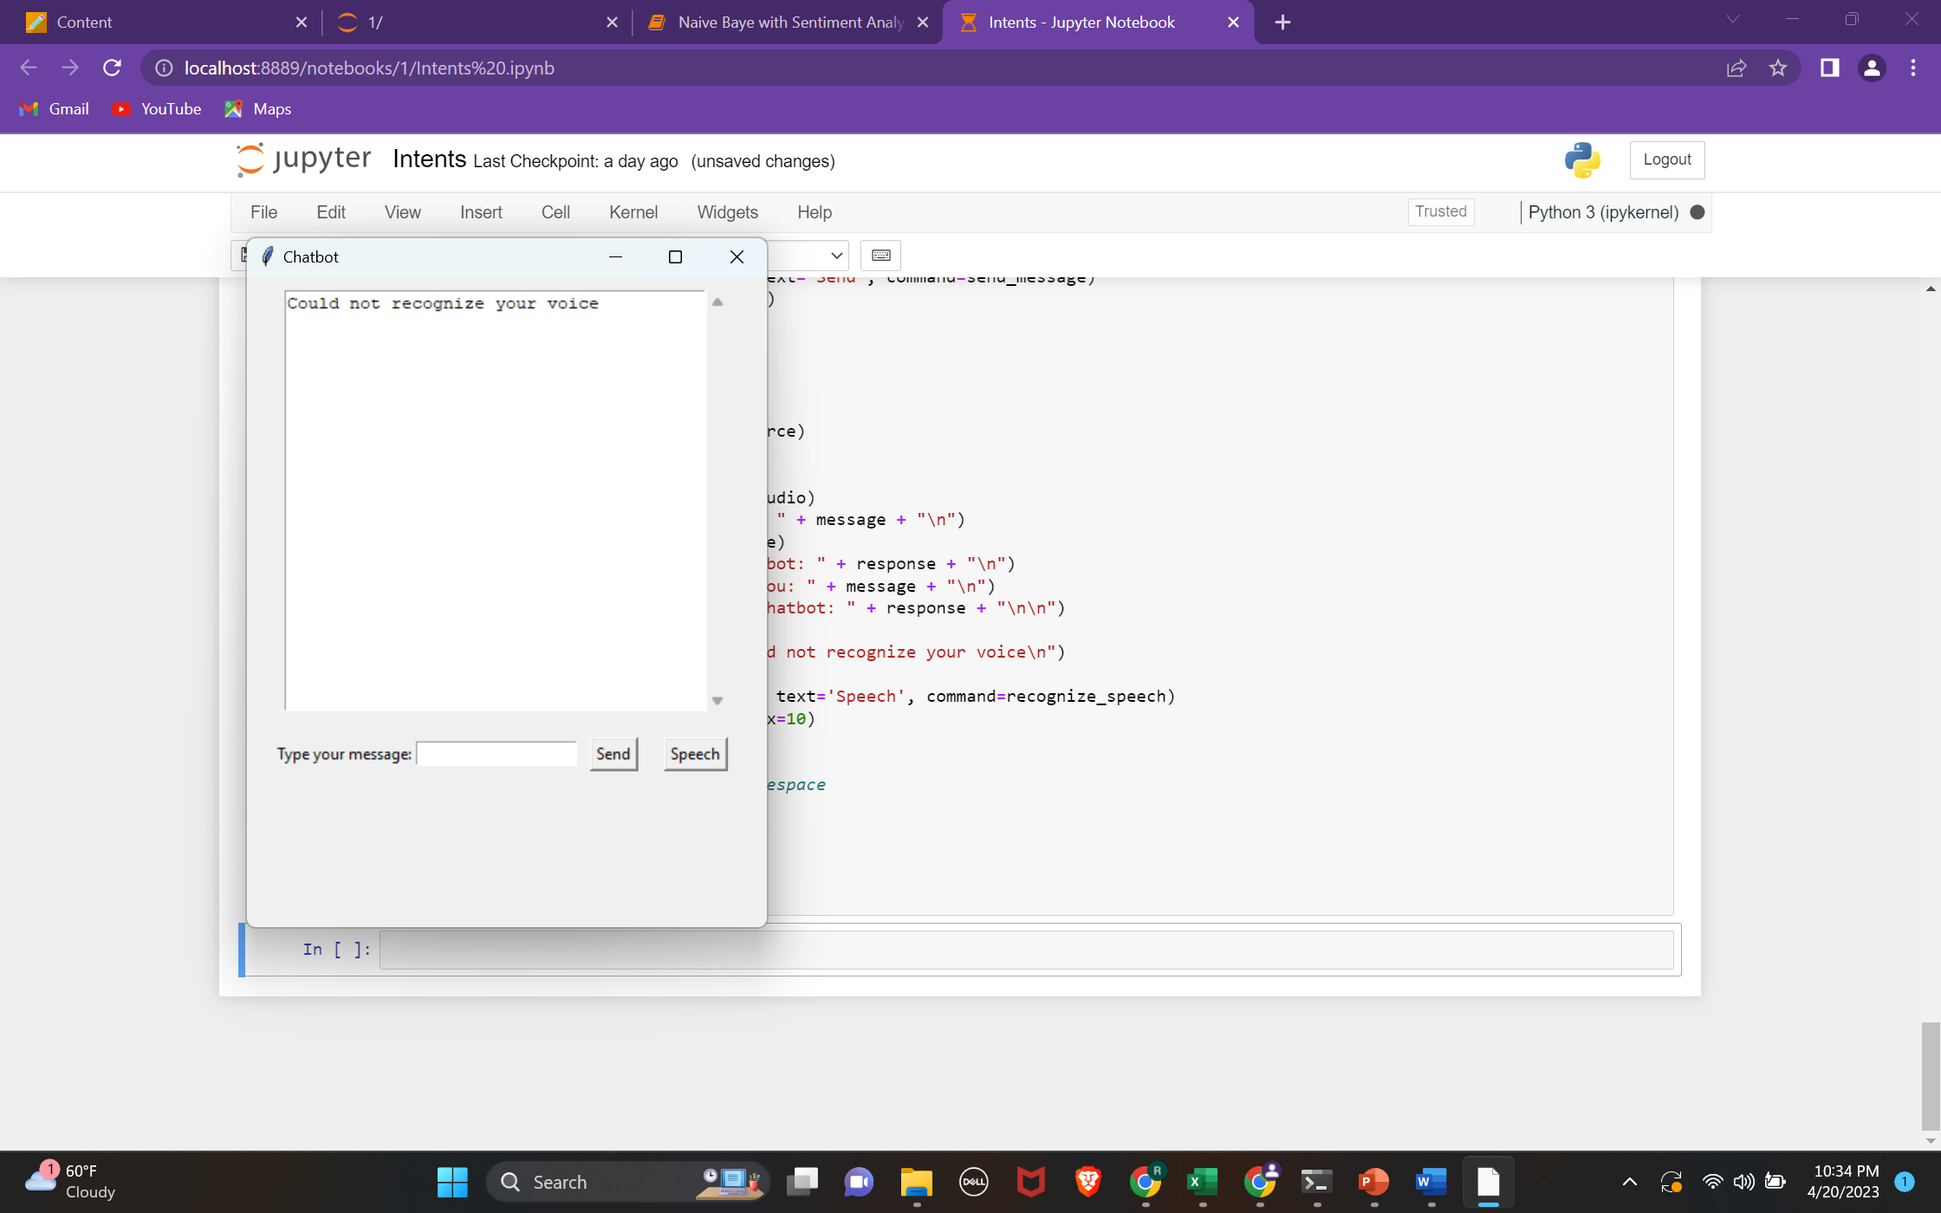
Chatbot Visualization

Slide 21
Future Work
To increase accuracy of the model :
More training data may be added in the future to increase the chatbot's accuracy by gathering real-world conversations or utilizing pre-existing datasets.
Natural language processing techniques like as sentiment analysis, named entity identification, and part-of-speech tagging may also be used to better comprehend and interpret user input, resulting in more accurate replies.
Part-of-speech tagging may also be used to better comprehend and interpret user input, resulting in more accurate replies

Slide 22
Thank You

